Slide 1
Network+ Wi-Fi coffeeshop installation
Presented by: Antonio Mendez
LAN-121-350 | Professor Lamberth

Slide 2
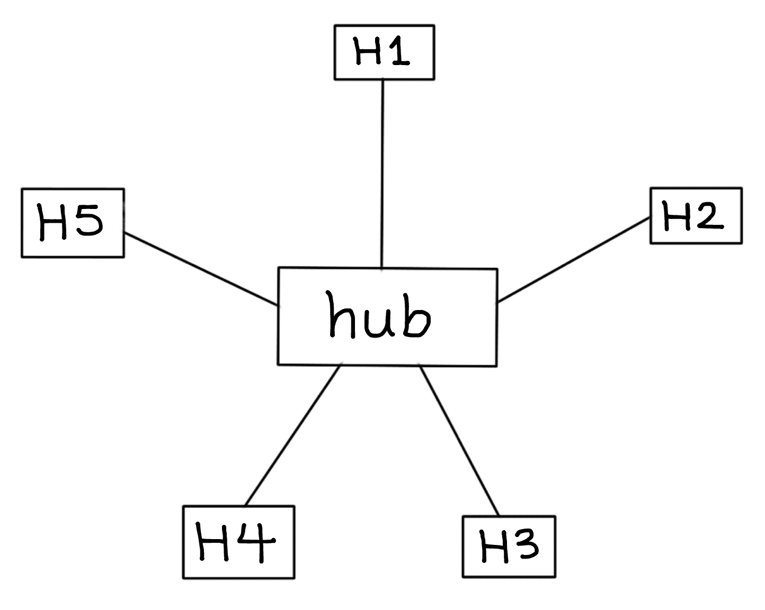
Introduction
My goal is to implement a network for at a local coffee shop. Where both the staff and clients have fast speed internet. I want to implement a network where more than 40 clients can be in the same network at the coffee shop while using their devices on a good network.
I plan to implement the star topology to the coffee shop, since the clients, staff, and the employer is going to need Wi-fi for the devices they are going to use.
I will have a router as a central hub to connect all the devices in the coffee shop to the Wi-Fi and securely separate the guest network.

Slide 3
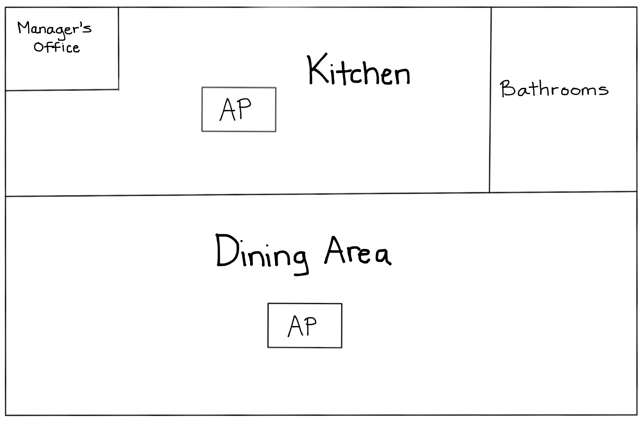
Implementation process
I would have two people to implement the network since it’s a task that can be completed in a day
I would have 1 router, 1 PoE switch, and 2 Aps so the connection can exceed past 40 customers
Implement IP addresses for the VLANs for the staff and guest
I would put the APs in an equal distance of 11.5 ft apart from each other to have an overlapping coverage area to allow seamless roaming between one WLAN cell to another, this will prevent internet blockage and interference with each other.
Encrypt the staff and guest network
Install client isolation on the guest network to prevent interaction with one another or the POS
Configure traffic by using QoS to prioritize POS traffic over customers to make sure that transactions never fail in the SSIDs
Lastly, use cloud-based monitoring tools to track network performance and troubleshoot and constantly update firmware on the network hardware to make sure nothing is prone to cyber attacks

Slide 4
Hardware for the Wi-Fi
Device | Model | Purpose
Router | Eero Pro 6 | Offer high stability and separate guest network, detects traffic,
Switch | PoE Switch | Segments traffic
Wireless AP | CW9800M | Connect devices to wired network wirelessly
POS System | Toast POS | Make the café’s service quicker and easier to manage
I plan to implement the 802.11ax wireless wi-fi technology for this coffee shop because it has lower latency and has improved power efficiency, with the help of OFDMA. This will connect as many devices to the coffee shop. Given the fact that it’s 30% faster than Wi-Fi 5.
For the business class cable, I will use the Cat 6 cable for the coffee shop because it’s cost effective and performs with lower latency for multiple people.

Slide 5
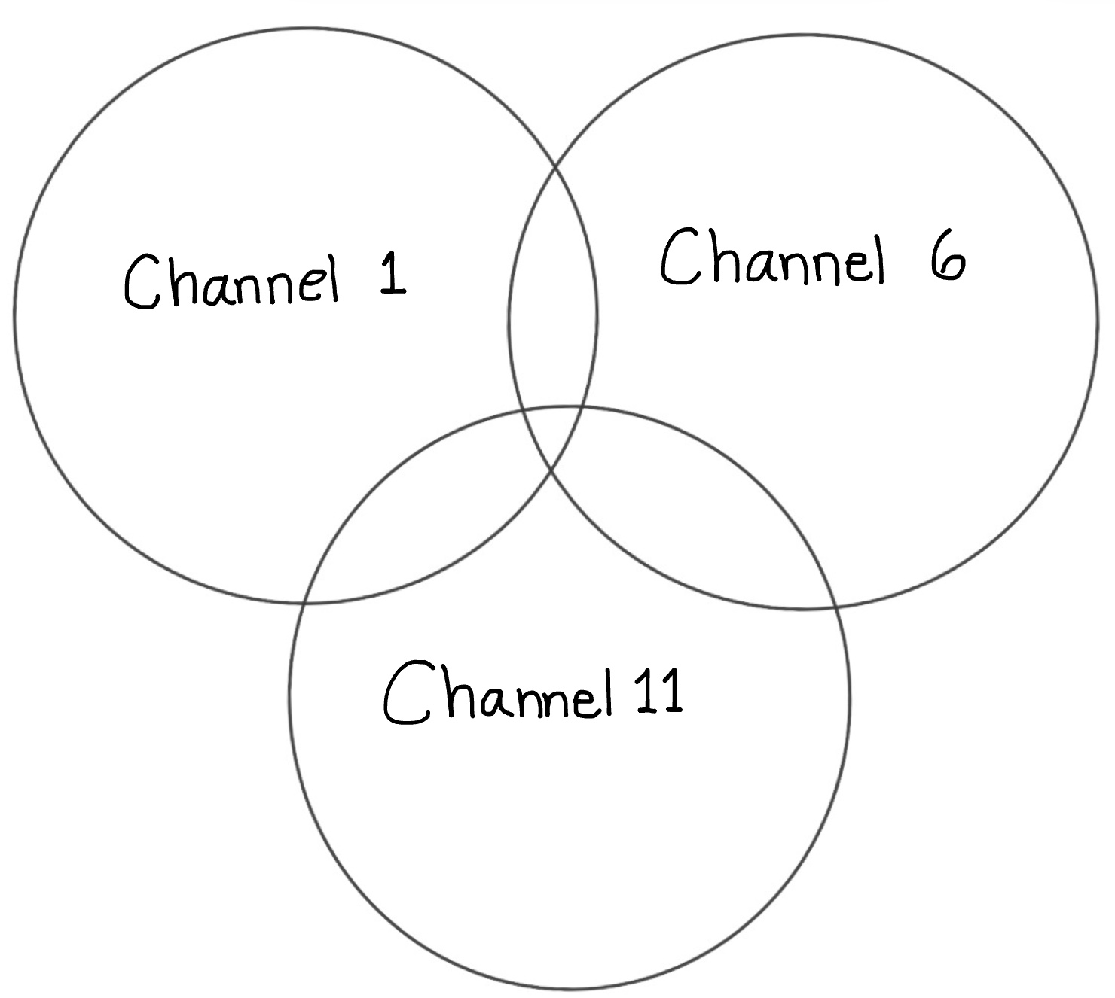
Channeling/VLANs implemtation
I will use channels 1,6, and 11 on 2.4GHz band because those channels won’t have frequencies that overlap. But it will have an overlapping coverage area to allow seamless roaming between one WLAN cell to another.
  If there was ever a time where there is more than 40 customers in the coffee shop, this will prevent interference.
I will create a VLAN that’s divided into 2 zones.
The IP range for the staff will fit best because it will avoid conflicts with other home routers nearby and can just have their own private network
The IP range for the guest network will fit best because this will avoid conflict from other routers. Also, it won’t run out of IP addresses if there’s >40 guests or if the coffee shop expands
Network | Purpose | IP Range
VLAN | Staff | 172.18.0.0
VLAN | Guest | 10.0.0.0

Slide 6
Network & encryption
By having SSIDs for staff and guest network, this will segment network traffic, which is a good choice for network security since everyone can be on the Wi-Fi without accessing sensitive data.
With Wi-Fi 6, staff will have high level security for when they access the POS system over public Wi-Fi. And clients will be satisfied with the internet speed while accessing their devices.
The type of wireless security that I want to implement for the staff is WPA3 to keep the staff’s personal information encrypted from cyber attacks. This counts as attacks on personal data or passwords.
Then guest network will have WPA2 to prevent their data being transmitted over the network on the Wi-Fi.
Authenticate the guest network by having the captive portal to accept terms of service before granting access to the network.
SSID | Network | Security
Staff | Wi-Fi 6 | WPA3
Guest | Wi-Fi 6 | WPA2

Slide 7
Testing & validation
To verify connectivity:
I would check if the network has received an IP address, subnet mask, and default gateway through DHCP by using the Ipconfig command.
I would also use the ping command to test out the routers and the public IP addresses to make sure the network reaches a wide distance.
The security testing measures:
Verify ACLs to make sure the guest network can’t communicate with the POS.
For coverage testing:
I would use heatmap to signal strength and interference in the coffee shop
I would also make sure that my device is connected anywhere inside the coffee shop by walking around.
For physical security purposes, keep the hardware somewhere safe to prevent theft and locate devices at a reasonable temperature to prevent system failures or overheating.
  IDEAL TEMPERATURE: 18 degrees Celsius and 27 degrees Celsius (64 degrees Fahrenheit to 80 degrees Fahrenheit).

Slide 8
Troubleshooting common issues
Issue | Cause | Solution
Slow Wi-Fi | APs being placed next to water or objects with metal | Remove any objects that slows the internet, such as aquariums or mirrors
No internet | Incorrect gateway or DNS | Change the assigned IP outside the DHCP scope, manually
POS offline | Security software blocking traffic | Ensure the POS software can communicate with the server

Slide 9
Documentation
Physical diagram/Logical diagram
Network Diagrams
Cable maps & Diagrams
IPAM
Wireless survey/ Heat map
Firmware updates
OS updates
Antonio Mendez | Cisco Inc.
I am confident this network implementation project will meet all key requirements for the coffee shop and will deliver significant value, thank you everyone for listening!

